Slide 1
High Performance Computing with R (Session 3)
Jason Hou-Liu
Department of Statistics and Actuarial Science, University of Waterloo

Slide 2
Parallel Computing

Slide 3
Parallel Computing
What is parallel computing?

Slide 4
Parallel Computing
CPU0
Task 1
Task 2
Task 3
Task 4
CPU1
CPU2
CPU3

Slide 5
Parallel Computing
CPU0
Task 1
Task 5
Task 9
Task 13
CPU1
Task 2
Task 6
Task 10
Task 14
CPU2
Task 3
Task 7
Task 11
Task 15
CPU3
Task 4
Task 8
Task 12
Task 16

Slide 6
Parallel Computing
Can all tasks be parallelized? Ideally:
Independent tasks
Don’t depend on each others’ results
Great use case: Simulation studies!

Slide 7
Amdahl’s Law
Speedup is less than the number of workers
Even though tasks are independent
Why?

Slide 8
Amdahl’s Law
CPU0
Task 1
Task 5
Task 9
Task 13
CPU1
Task 2
Task 6
Task 10
Task 14
CPU2
Task 3
Task 7
Task 11
Task 15
CPU3
Task 4
Task 8
Task 12
Task 16
This is really an idealized setup.

Slide 9
Amdahl’s Law
CPU0
Task 1
Task 5
Task 9
Task 13
CPU1
Task 2
Task 6
Task 10
Task 14
CPU2
Task 3
Task 7
Task 11
Task 15
We don’t always have an even distribution of tasks
CPU3
Task 4
Task 8
Task 12
Task 16

Slide 10
Amdahl’s Law
CPU0
Task 1
Task 5
Task 9
CPU1
Task 2
Task 6
Task 10
CPU2
Task 3
Task 7
CPU3
Task 4
Task 8
Run-to-run variance

Slide 11
Amdahl’s Law
CPU0
Task 1
Task 5
Task 9
CPU1
Task 2
Task 6
Task 10
CPU2
Task 3
Task 7
CPU3
Task 4
Task 8
Dispatch and collection time (sequential)

Slide 12
apply family refresher
apply
lapply
sapply
vapply
mapply
tapply
replicate
Many variations on a theme
We’ll focus on the first 3

Slide 13
apply-family Refresher

Slide 14
apply family refresher
for loops
lapply
input = list(a, b, c, d)
output = list()
for (i in 1:n) {
x = f(input[[i]])
y = g(x)
z = h(y)
output[[i]] = z
}
output = lapply(input, function(in) {
x = f(in) y = g(x) z = h(y)
return(z)
}
)

Slide 15

apply family refresher
One common gripe with the apply family is:
No progress bar!
pbapply package
Progress bar and ETA
Accuracy not guaranteed

Slide 16
apply family refresher
apply(...) = pbapply(...)
sapply(...) = pbsapply(...)
lapply(...) = pblapply(...)
library(pbapply)
output = pblapply(input,
function(in) {
x = f(in)
y = g(x)
z = h(y)
return(z)
}
)

Slide 17
Parallel with pbapply

Slide 18
pbapply package
pbapply provides more than a progress bar…
Adding parallel is also super easy!
lapply(X, FUN, ...) pblapply(X, FUN, ..., cl = NULL)

Slide 19
pbapply package
What goes into the cl argument?
A cluster object created by makeCluster,
or an integer to indicate number of child-processes (integer values are ignored on Windows)…
It can also be "future" to use a future backend (see Details),
NULL (default) refers to sequential evaluation.

Slide 20


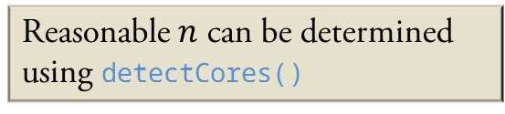
Creating a cluster
parallel package!
cl = makeCluster(n)
Open Task Manager/Activity Monitor
Windows: More details
Keep an eye on it for now
Reasonable $n$ can be determined using detectCores()

Slide 21
Using pbapply package with a cluster
# Generate 10000 replicates of the iris dataset
input = replicate(10000, iris)
# Using pbapply with a progress bar
output = pblapply(input, function(x) eigen(cov(iris[-5])))
# Using pbapply with a progress bar, and a cluster
output = pblapply(input,
function(x) eigen(cov(iris[-5])),
cl = cl)

Slide 22
Using pbapply package with a cluster
Bring up Task Manager/Activity Monitor
What do you see?
CPU usage?

Slide 23
Using pbapply package with a cluster
What about something a bit more complicated?
Logistic regression
Leave-One-Out Cross-Validation (LOOCV)
Error?
When you make a cluster, each worker is a blank R slate
iris is available in R at all times, so no error

Slide 24
Exporting Objects to Cluster
To send objects to each worker, use the clusterExport function:
clusterExport(cl = cl, c(“object1”, “object2”, …))
You can send almost any R object such as data frames, functions, and lists.
Avoid clusterExport(cl = cl, ls()) unless you’re sure you want to do this!

Slide 25
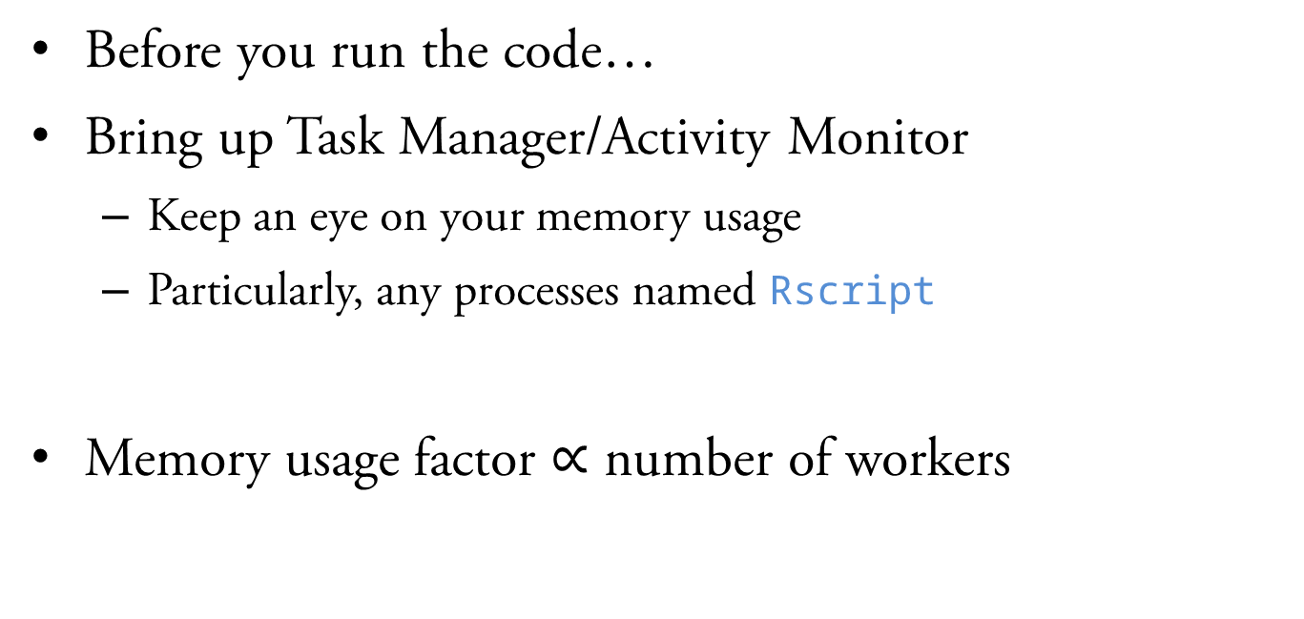
Exporting Objects to Cluster
Before you run the code…
Bring up Task Manager/Activity Monitor
Keep an eye on your memory usage
Particularly, any processes named Rscript
Memory usage factor $∝$ number of workers

Slide 26
Loading Libraries in a Cluster
What if you need a library in the cluster?
clusterEvalQ(cl = cl, {
# Any code you want to run on each R worker
library(Rfast)
})
Can be used to run any code
e.g.) Loading a big dataset
Wrap clusterEvalQ() in invisible() to suppress printing the return values
Be careful about implicitly returning the last value!

Slide 27
Revisit: Amdahl’s Law
CPU0
Task 1
Task 5
Task 9
CPU1
Task 2
Task 6
Task 10
CPU2
Task 3
Task 7
CPU3
Task 4
Task 8
Dispatch and collection time (sequential)
pbapply can only update progress here

Slide 28
Revisit: Amdahl’s Law
Before you run the code…
Bring up Task Manager/Activity Monitor
Show each individual process (Windows: Details tab)
Find all the processes named Rscript
Watch the dispatch and retrieval in real-time

Slide 29
Revisit: Amdahl’s Law
We can somewhat fix this:
pboptions(use_lb = TRUE, nout = 1)
At the cost of:
A useful progress bar
Consistent execution order

Slide 30
Revisit: Amdahl’s Law
CPU0
Task 1
Task 5
Task 9
CPU1
Task 2
Task 6
Task 10
CPU2
Task 3
Task 7
CPU3
Task 4
Task 8

Slide 31
Revisit: Amdahl’s Law
CPU0
Task 1
Task 5
Task 10
Task 9
CPU1
Task 2
Task 6
CPU2
Task 3
Task 8
CPU3
Task 4
Task 7

Slide 32
Remote HPC Usage

Slide 33
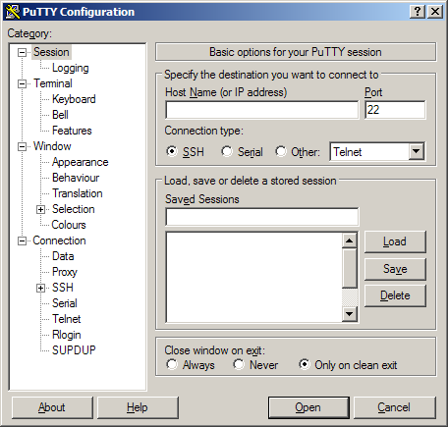
Remote HPC Usage
Your laptop is great and all
But it’s no HPC cluster
Use PuTTY and FileZilla to log into the SSC cluster
Or you may use your own!

Slide 34
Remote HPC Usage
Demo & Hands-on with the cluster
How to run parallel R code remotely
How to send/receive data
How to share the cluster with others
How to leave code running unattended

Slide 35
Simulation Design

Slide 36
Simulation Design
Run lots of simulation configurations
Different settings
Lots of replications
Build a design matrix!

Slide 37
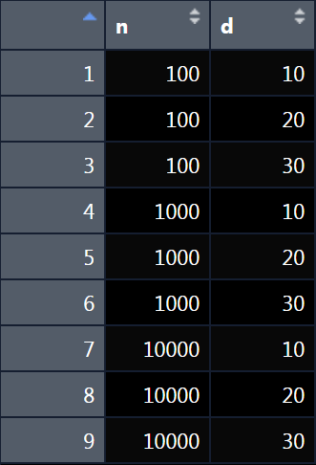
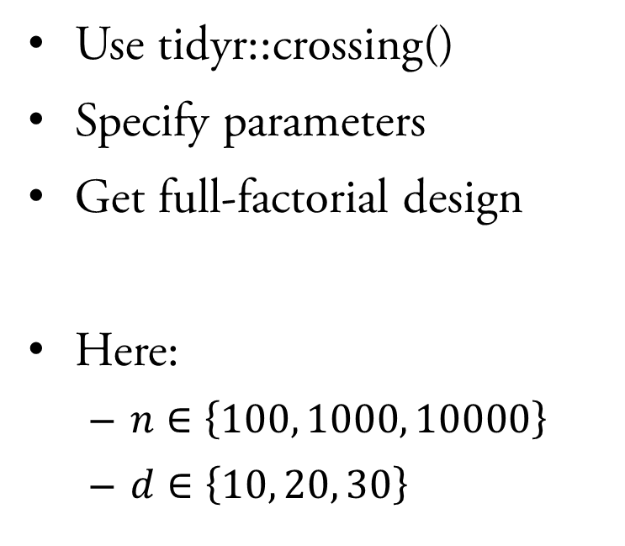
Build a Design Matrix
Use tidyr::crossing()
Specify parameters
Get full-factorial design
Here:
$n∈\left\{100, 1000, 10000\right\}$
$d∈\left\{10, 20, 30\right\}$

Slide 38
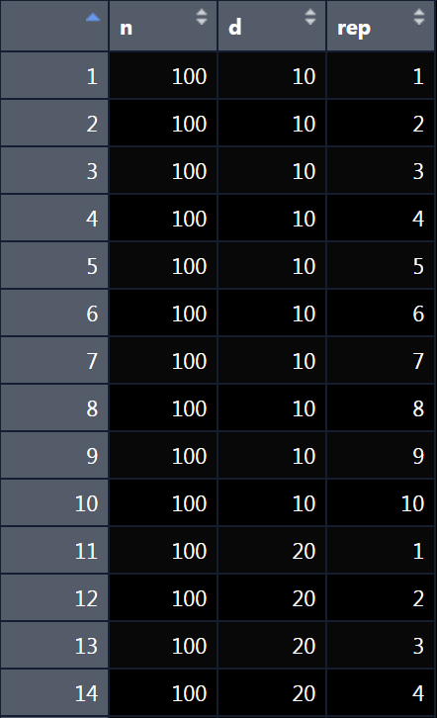

Build a Design Matrix
What about replications?
Add a dummy variable
For 10 replications:
$rep∈\left\{1,2,…,10\right\}$

Slide 39
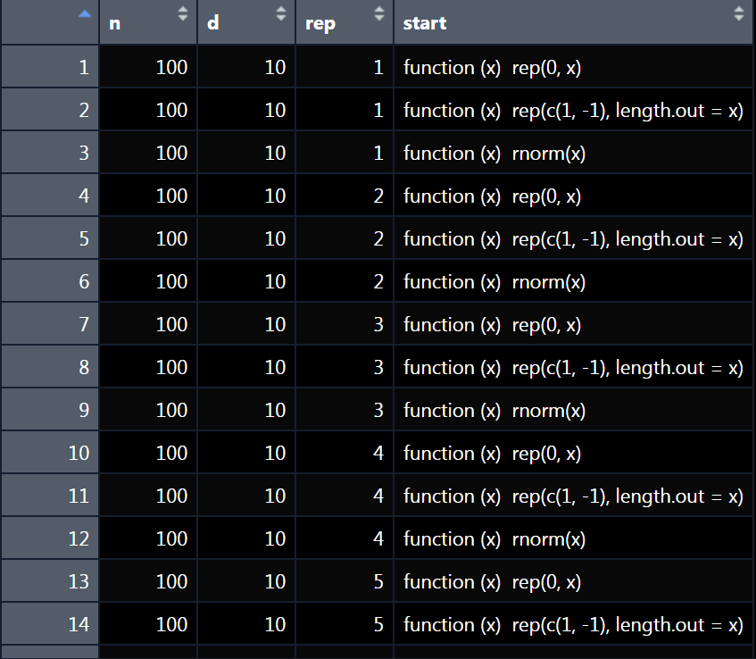
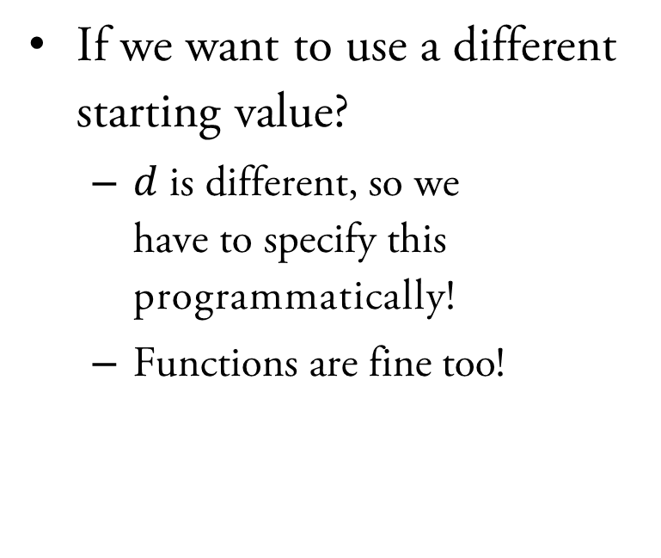
Build a Design Matrix
If we want to use a different starting value?
$d$ is different, so we have to specify this programmatically!
Functions are fine too!

Slide 40
Aside: Why tibbles and not data.frames?
Printing a tibble
Printing a data frame
> pars
# A tibble: 270 x 4
n d rep start
<dbl> <dbl> <int> <list>
1 100 10 1 <fn>
2 100 10 1 <fn>
3 100 10 1 <fn>
4 100 10 2 <fn>
5 100 10 2 <fn>
6 100 10 2 <fn>
7 100 10 3 <fn>
8 100 10 3 <fn>
9 100 10 3 <fn>
10 100 10 4 <fn>
# i 260 more rows
# i Use `print(n = ...)` to see more rows
> as.data.frame(pars)
n d rep start
1 100 10 1 function (x) , rep(0, x)
2 100 10 1 function (x) , rep(c(1, -1), length.out = x)
3 100 10 1 function (x) , rnorm(x)
4 100 10 2 function (x) , rep(0, x)
5 100 10 2 function (x) , rep(c(1, -1), length.out = x)
6 100 10 2 function (x) , rnorm(x)
7 100 10 3 function (x) , rep(0, x)
8 100 10 3 function (x) , rep(c(1, -1), length.out = x)
9 100 10 3 function (x) , rnorm(x)
10 100 10 4 function (x) , rep(0, x)
11 100 10 4 function (x) , rep(c(1, -1), length.out = x)
12 100 10 4 function (x) , rnorm(x)
13 100 10 5 function (x) , rep(0, x)
14 100 10 5 function (x) , rep(c(1, -1), length.out = x)
15 100 10 5 function (x) , rnorm(x)
16 100 10 6 function (x) , rep(0, x)
17 100 10 6 function (x) , rep(c(1, -1), length.out = x)

Slide 41
Using the Design Matrix
Since the design matrix is just another variable…
Export it to the cluster!
clusterExport(cl = cl, “pars”)
output = pblapply(1:nrow(pars),
function(i) {...},
cl = cl)

Slide 42
Using the Design Matrix
We can bind the output list of results onto the design matrix too!
Save this object to capture your entire simulation
> par.out
# A tibble: 270 x 5
n d rep start output
<dbl> <dbl> <int> <list> <list>
1 100 10 1 <fn> <named list>
2 100 10 1 <fn> <named list>
3 100 10 1 <fn> <named list>
4 100 10 2 <fn> <named list>
5 100 10 2 <fn> <named list>
6 100 10 2 <fn> <named list>
7 100 10 3 <fn> <named list>
8 100 10 3 <fn> <named list>
9 100 10 3 <fn> <named list>
10 100 10 4 <fn> <named list>
# i 260 more rows
# i Use `print(n = ...)` to see more rows

Slide 43
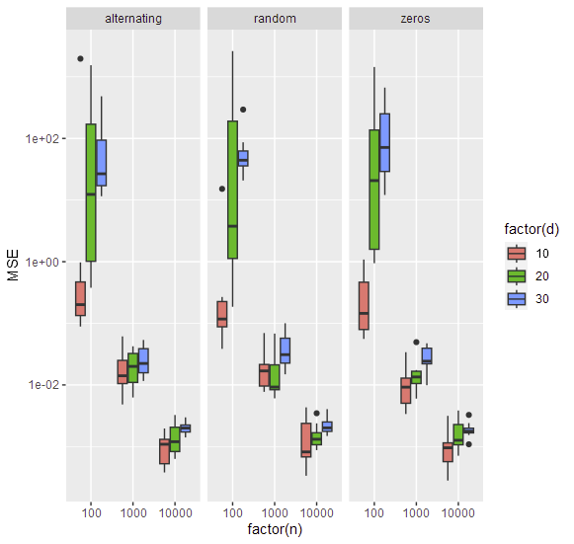
Processing the Result
Can process the result using dplyr and ggplot2
rowwise() is your friend
Can address the output list-column elements by name
Tidy (tabular) data principles apply

Slide 44
Tips and Tricks

Slide 45
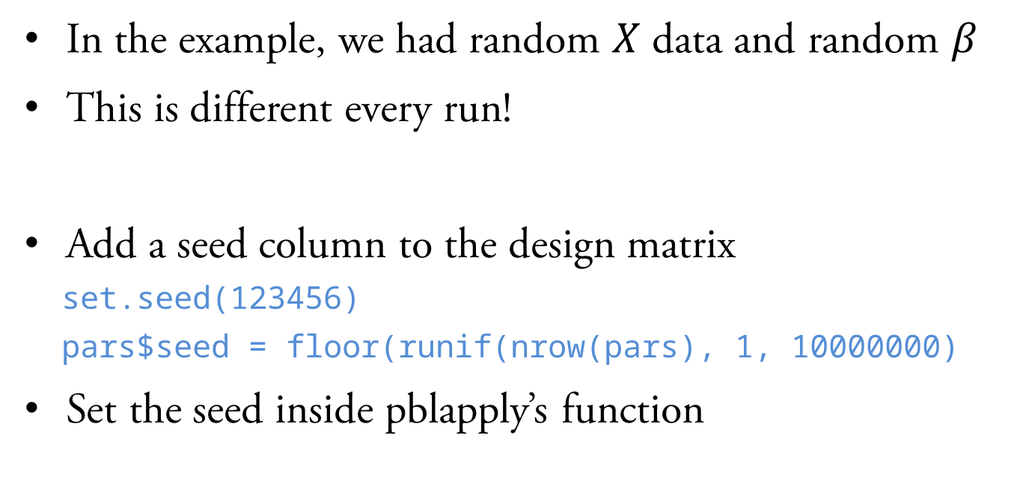
Reproducibility
In the example, we had random $X$ data and random $β$
This is different every run!
Add a seed column to the design matrix
set.seed(123456)
pars$seed = floor(runif(nrow(pars), 1, 10000000)
Set the seed inside pblapply’s function

Slide 46
Error Handling
Code is almost never perfect
Inputs are almost never perfect
What happens inside (pb)lapply?
All returns are lost
pblapply doesn’t tell you which input failed

Slide 47
Unattended Saving
At the end of your remote HPC’s R script
Remember to save your results!
For your future self…
Leave comments in the code
Save files with helpful file names
Timestamp!

Slide 48
OpenBLAS

Slide 49
Can’t parallelize in R?
What happens if not parallelizable?
At least speed up linear algebra
Replace BLAS library with something faster

Slide 50
OpenBLAS
Basic Linear Algebra Subroutines
Many choices of BLAS libraries
R defaults to the reference BLAS
Can (often) be replaced by a faster one
set.seed(1)
X = rWishart(1, 5e3, diag(5e3))[,,1]
system.time(eigen(X))

Slide 51
OpenBLAS
Diminishing returns
Increasing overhead
Can be tricky to optimize

Slide 52
Drawbacks
Drawbacks:
Results are numerically different from reference
May be less portable
May be less reproducible
Do not parallelize using OpenBLAS and R at the same time (unless you know what you’re doing)

Slide 53
Demonstration on Cluster
The cluster is equipped with OpenBLAS
R will use it!
Hands-on demonstration…

